Slide 1
OpenCDMS
Working together to improve Climate Data Management Systems
Notes:
The first 5 slides relate to the emerging OpenCDMS strategy (adapted from a presentation given to the CLIDATA team in October 2020)

Slide 2
Principle aims for OpenCDMS...
1. Improve interoperability among existing CDMSs
2. Work to support, and collaborate with, existing projects with the intention of ensuring CDMS users continue to benefit from existing support structures and services
Create a Reference Implementation for a fully-compliant next-generation CDMS (with guidance from expert teams and a broad range of implementers)

Slide 3
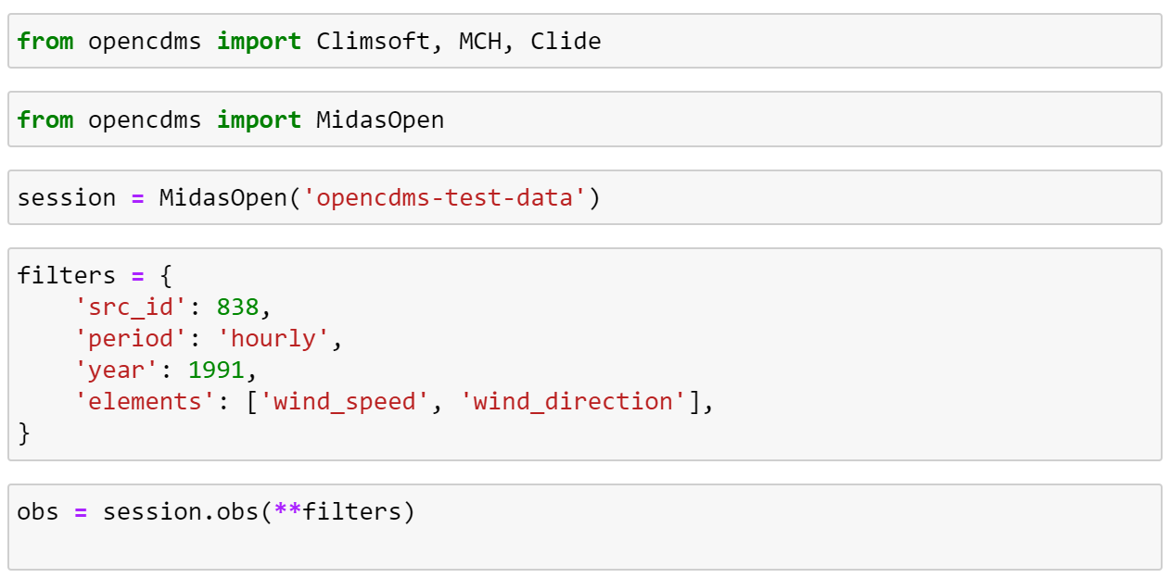
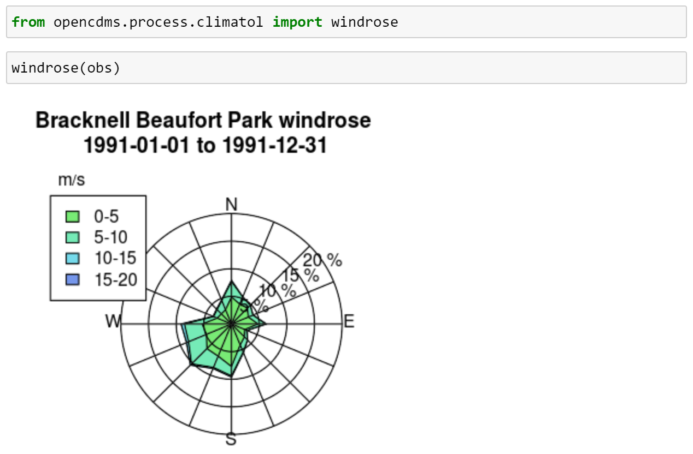
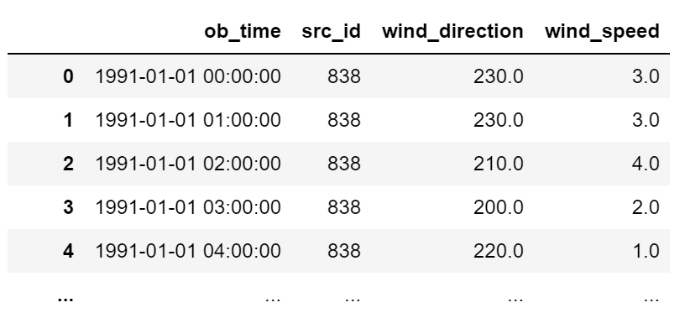
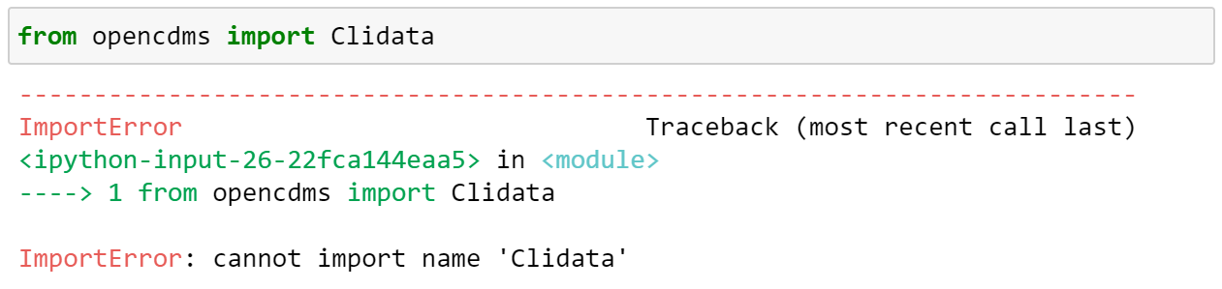
1. Improve interoperability among existing CDMSs

Slide 4
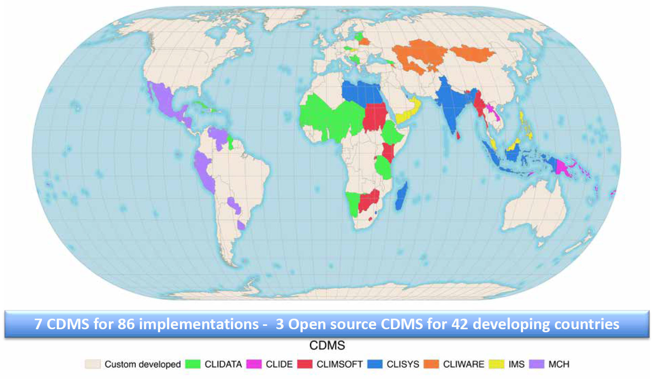
2. Work to support, and collaborate with, existing projects with the intention of ensuring CDMS users continue to benefit from existing support structures and services
Notes:
This is what makes OpenCDMS fundamentally different to systems like WHOS and C3S CDS

Slide 5



3. Create a Reference Implementation for a fully-compliant next-generation CDMS
Climate Data Management System
Standard
CDMS Reference
Implementation
- Compliance testing
- Certification

Slide 6
OpenCDMS 2021 Initial planning meeting
ACP 2.4 – OpenCDMS ACP (Climsoft – MCH – CliDE …)
Activities beyond ACP (Météo France – Met Office …)

Slide 7
(i) ACP 2.4 – OpenCDMS ACP (Climsoft – MCH – …)
OpenCDMS
Web API
OpenCDMS Business Logic and Python API
MCH
DB
Climsoft
DB
CliDE
DB
“known”

Slide 8
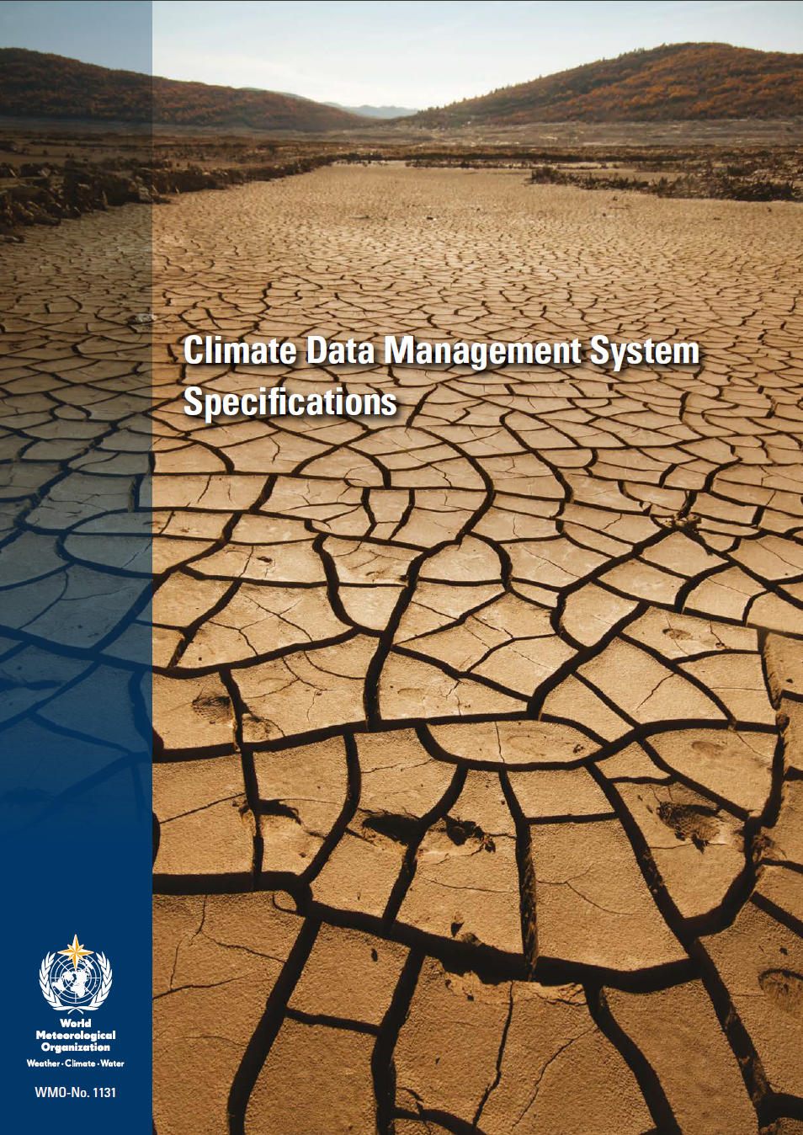
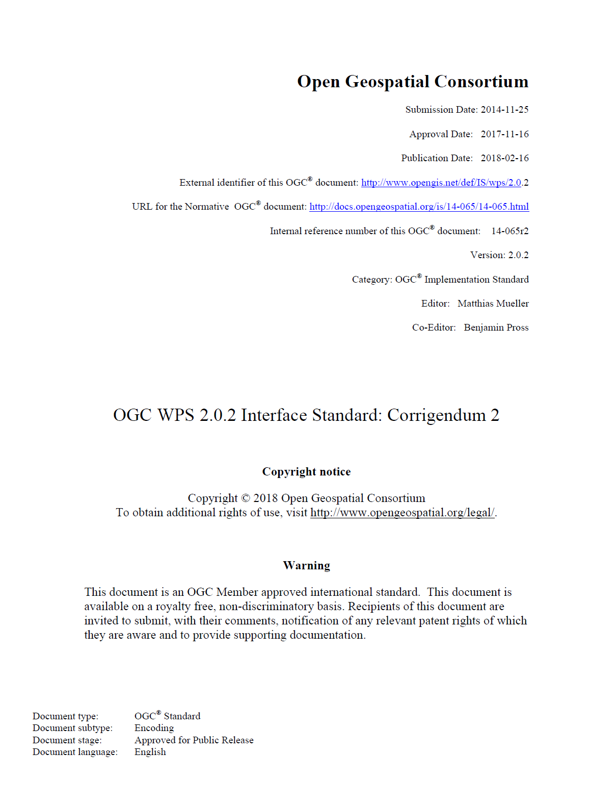
(ii) Activities beyond ACP
WMO
CDMS API
CDMS API Reference
Implementation
CDMS Specifications
CDMS API Standard

Slide 9
(i) ACP 2.4 – OpenCDMS ACP (Climsoft – MCH – …)
OpenCDMS
Web API
CDMS API Standard
OGC EDR
OpenCDMS Business Logic and Python API
MCH
DB
Climsoft
DB
CliDE
DB
Reference Implementation
MIDAS
DB
“known”
“to be determined”
Notes:
OpenCDMS Web API should inform the CDMS API Standard. The former may be replaced with the later

Slide 10

1. User story
In this case it is simply taken from our existing process catalog
Station Entry
Enables entry and modification of station details
Metadata management Epic
Notes:
https://www.atlassian.com/agile/project-management/user-stories

Slide 11
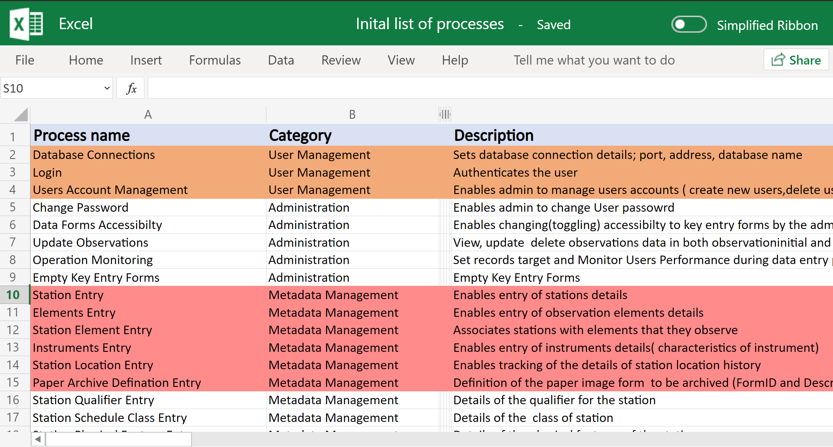

Slide 12
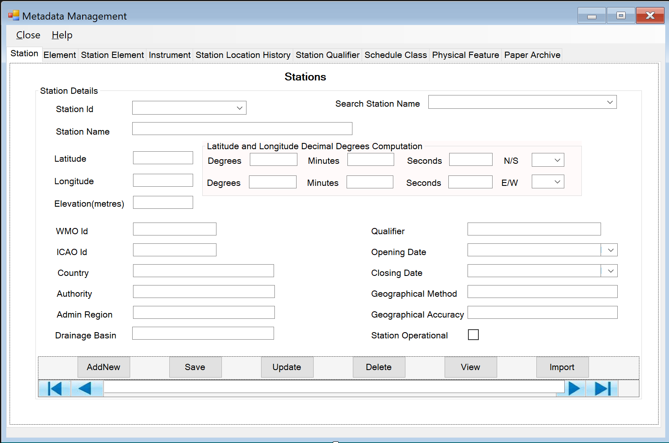
Example non-functional requirement OpenCDMS User Interface – Station Entry
(Administrators have the option to choose a Climsoft “theme” or “installation profile” for input forms)
Non-functional Requirement:
Station metadata management should have a similar look and feel to the original version when using the OpenCDMS “Climsoft theme”
Notes:
(e.g. we’ll take lots of screenshots from existing systems)

Slide 13
2. Functional requirements – Station Entry
All users with a “station metadata role” will be able to edit station metadata
When adding a new station, station name and ids will only be accepted if a station with these attributes does not already exist
When entering the latitude and longitude location of the station a check will be made to ensure the location falls within the boundary of the administrative area (e.g. country or county)
When entering a WMO id or ICAO id, the id will be checked for validity. WMO id must be 5-character alpha-numeric value
Separating expert knowledge from implementation will speed up development. We could have external contributors & volunteers working on the implementation
Notes:
Example when recording observations – An observation cannot be recorded for a station unless that station is recorded as being “open” at the time of observation.
This is the complex business logic. It takes a long time to get it correct, and it must be correct. If we don’t write it out like this then we cannot get external validation. Each functional requirement can be linked to the function that implements it, therefore this is essentially work we would do anyway in the docstring.

Slide 14
3. Acceptance tests – Station Entry
Functional requirement: When adding a new station, station name and ids will only be accepted if a station with these attributes does not already exist
CSV data with existing station data (or use data from existing test database)
Function call passing a station ID that already: add_station('838')
Function raises appropriate custom exception

Slide 15
Year | Half/Quarter | ACP Tasks | RI Tasks
2020 |  | Key outcomes: Initial DataAPI in YAML → Initial Data and Process APIs in Python
 |  | Process Library with docstrings and automated tests (minimum R-Instat 4 of 80, MCH 1 of 20)
 |  | Data model review and recommendations
2021 | H1 | User stories, functional requirements & acceptance tests for existing CDMSs | User stories, functional requirements and acceptance tests for Reference Implementation
 |  | Completion of processes with docs & tests | Engagement with other projects, e.g. CST
 | H2 | Web API design and initial web components for user interface | CDMS API Standard and Reference Implementation to follow CDMS Specs
2022 |  | User interface
2023 | Q1 | Begin hardware procurement
 | Q2 | June 2023 – Cg-19 Congress
 | Q3 | Begin in-county implementation/training
 | Q4
2024 | Q1 | Complete in-county implementation/training
 | Q2 | June 2024 – ACP project ends
 | Q3 | ACP Project possible no-cost extension

